Slide 1


Language modeling using Tree-Based Methods
15.095 ML under a Modern Optimization Lens – Final Project
Team Members: Seth Chatterton, Jason Jia

Slide 2
Problem and motivation
Neural networks such as Transformers are highly popular as models of choice for autoregressive language modeling (predicting the next token/character/word).
However, they are computationally expensive to train.
On the other hand, tree-based models such as XGBoost, RF, CART and OCT can be easier to train and might be able to generate similar predictions
CART and OCT can even be interpretable
This is also in light of the proof in class that neural networks are equivalent to trees under certain assumptions.
We would thus like to experiment with tree-based methods and compare their performance with established neural network-based methods for autoregressive language modeling.

Slide 3
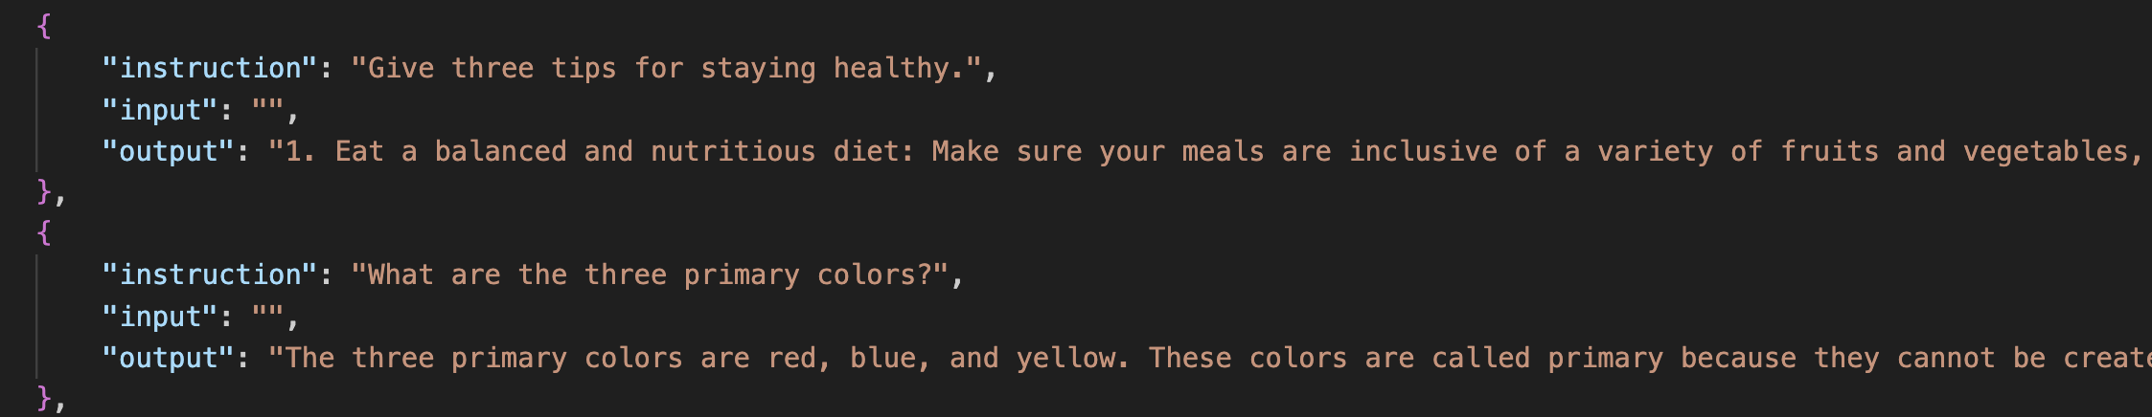
Data
Cleaned Alpaca Dataset, a slightly modified version of the dataset used to train the Alpaca large language model.
The data consists of instructions for the model, inputs for those instructions, and outputs that the model should try to recreate.

Slide 4
methods
Preprocessing
Tree-Based Methods
CART, Random Forest, XGBoost
Benchmarks
Feed Forward Neural Networks
Evaluation
Training and Test Accuracy
Training Time
Interpretability

Slide 5
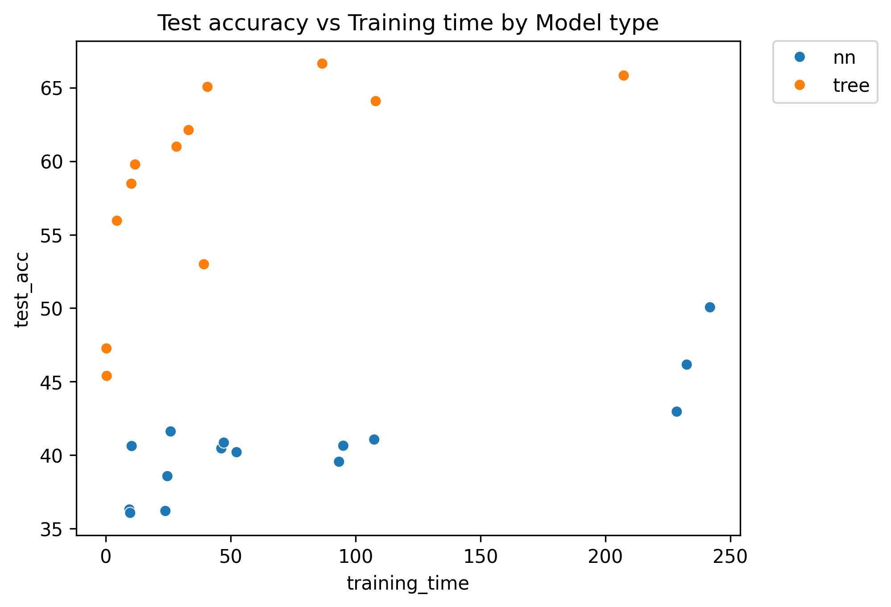
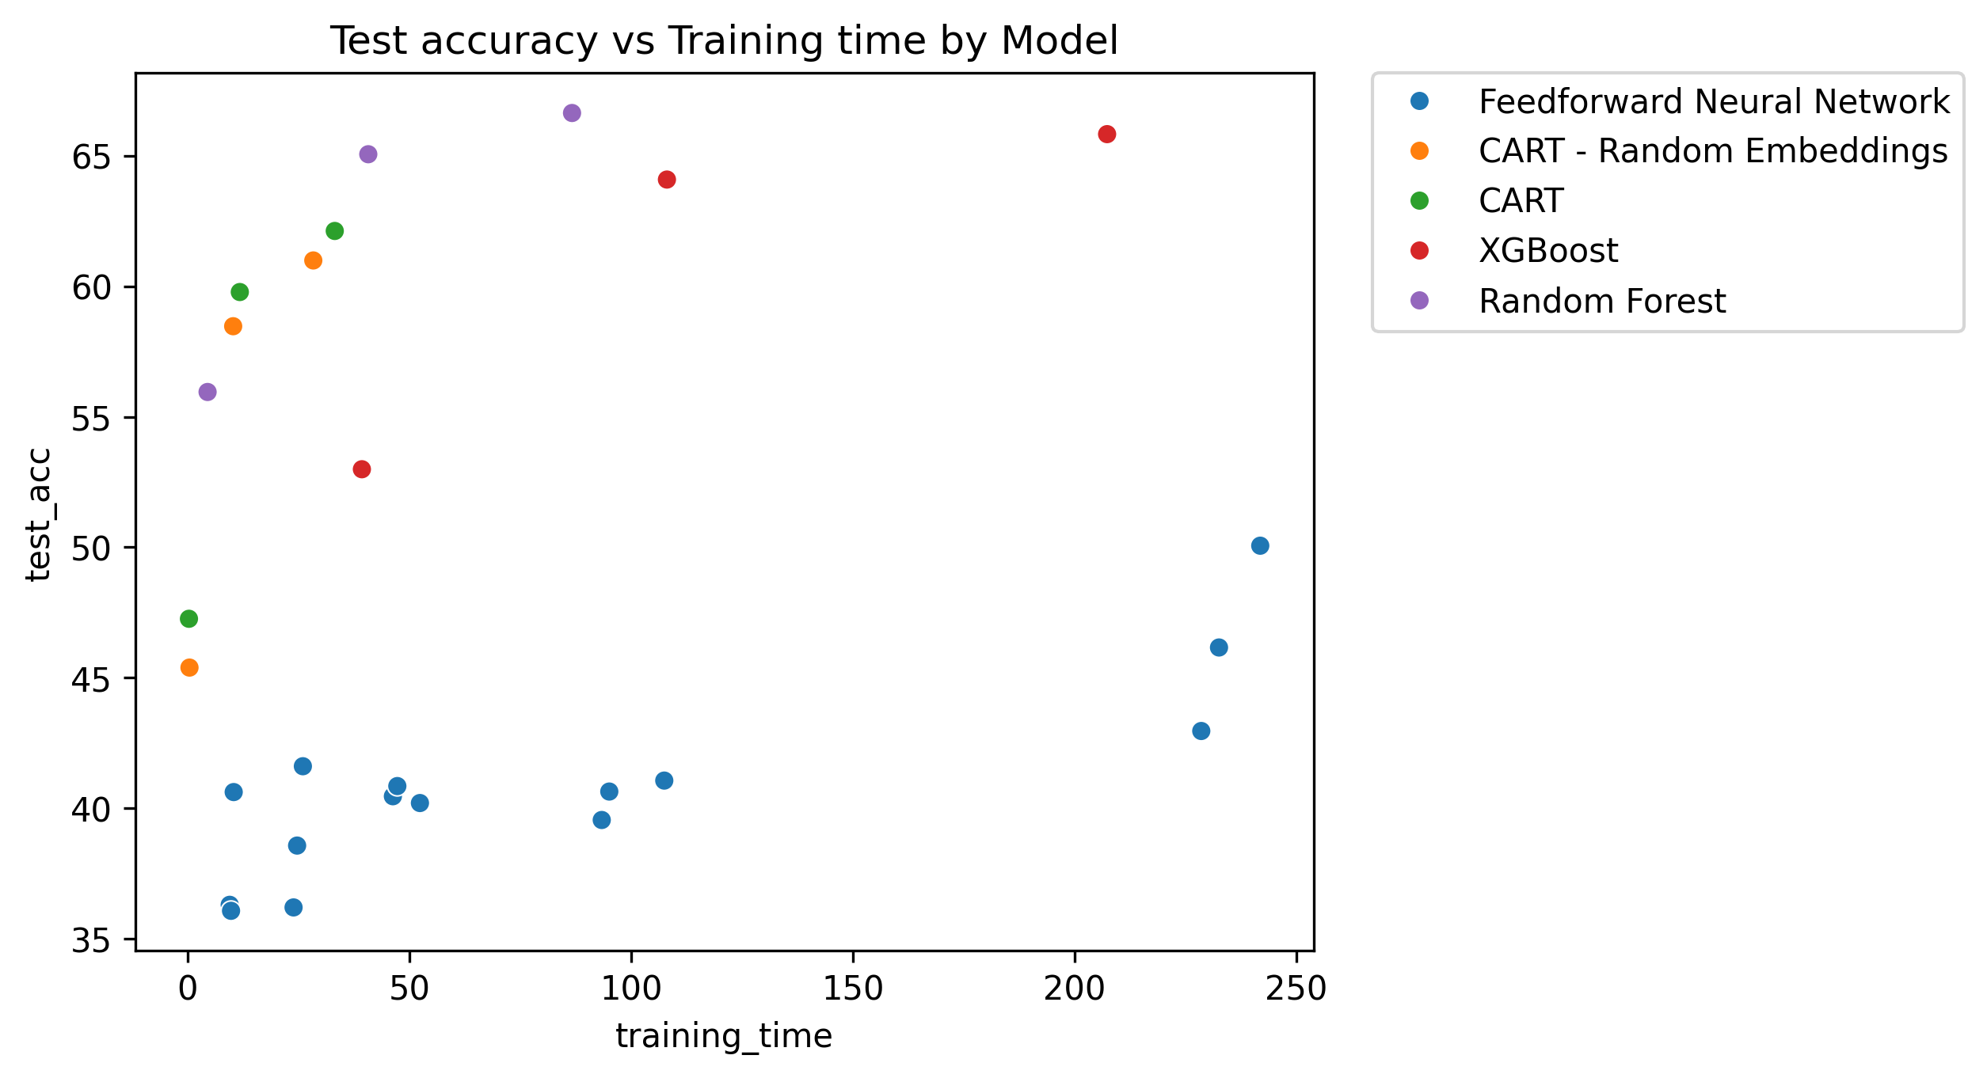
Key findings Tree-based methods can sometimes outperform neural networks in next character prediction.
Method | Embedding size | Train Accuracy (%) | Test Accuracy (%) | Training Time (s)
FFN | 32 | 49.98 | 50.06 | 801.5
CART – RE | 8 | 83.56 | 60.99 | 28.35
CART | - | 80.39 | 62.12 | 33.19
XGBoost | - | 90.22 | 65.83 | 207.4
Random Forest | - | 90.36 | 66.64 | 86.7

Slide 6
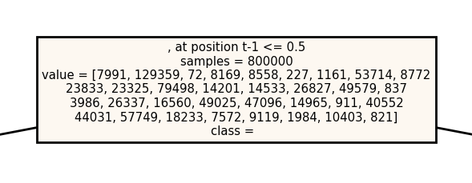
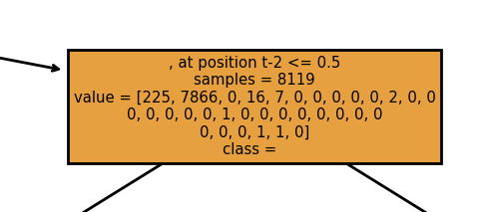
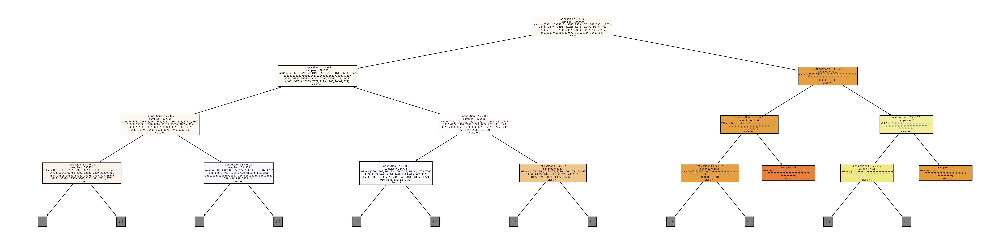
Interpretability

Slide 7
Impact
Our findings suggest that tree-based methods may be viewed as a viable alternative to neural network methods for next character prediction, given small to medium datasets (<1M training examples).
…???

